Slide 1
What Is Tidy Data?

Slide 2
The Data Science Pipeline

Slide 3
Tidy Data
So far we have assumed that the data we have imported have been in a form that we can readily transform and visualize. That is… the data thus far have been “tidy.” This is not always the case.
So what is “tidy data”?
Each variable must have its own column.
Each observation must have its own row.
Each value must have its own cell.

Slide 4
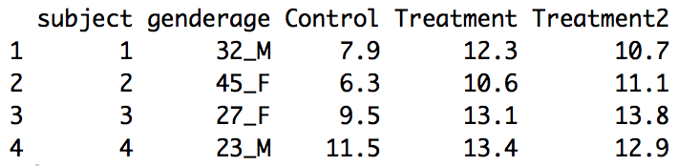
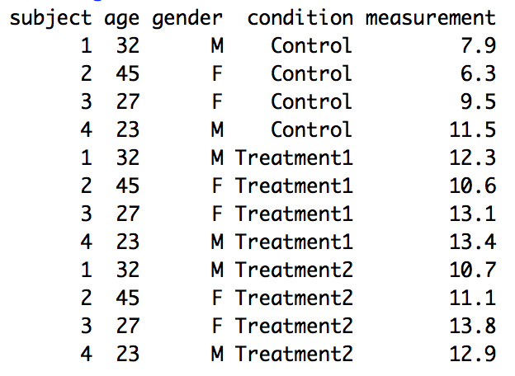
Example 1
Not Tidy
Each variable not in its own column
Tidy
Each observation not in its own row.
Notes:
#Example 1a
olddata_wide <- read.table(header=TRUE, text='
subject genderage Control Treatment1 Treatment2
1 32_M 7.9 12.3 10.7
2 45_F 6.3 10.6 11.1
3 27_F 9.5 13.1 13.8
4 23_M 11.5 13.4 12.9
')
olddata_wide$subject <- factor(olddata_wide$subject)
#Change to Long
data_long <- gather(olddata_wide, condition, measurement, Control:Treatment2, factor_key=TRUE)
data_long = data_long %>% separate(genderage, into = c("age","gender"))
data_long

Slide 5
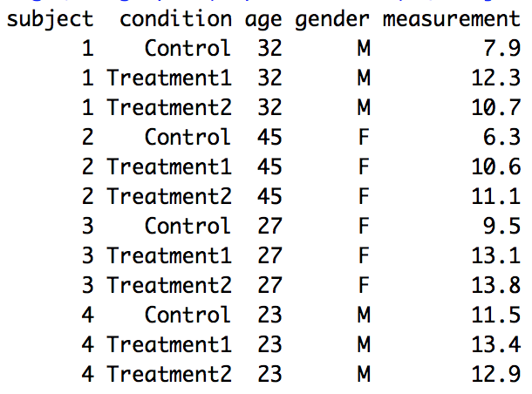
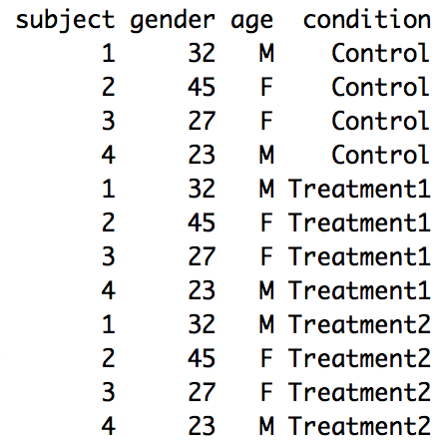
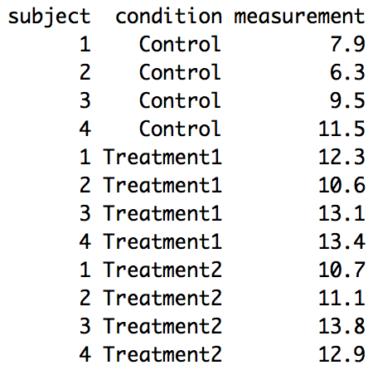
Example 2
Not Tidy
Tidy
Dataset 1
Dataset 2

Slide 7
Making Data Tidy | How and Why
gather(), spread() and separate()

Slide 8
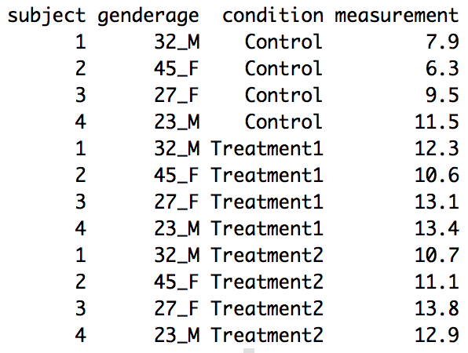
Wide v. Long Data | gather() and spread()
Wide
Long
Notes:
#Example 1a
olddata_wide <- read.table(header=TRUE, text='
subject genderage Control Treatment1 Treatment2
1 32_M 7.9 12.3 10.7
2 45_F 6.3 10.6 11.1
3 27_F 9.5 13.1 13.8
4 23_M 11.5 13.4 12.9
')
olddata_wide$subject <- factor(olddata_wide$subject)
#Change to Long
data_long <- gather(olddata_wide, condition, measurement, Control:Treatment2, factor_key=TRUE)
data_long

Slide 9
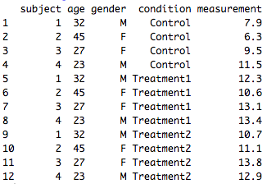
separate()
Long Data but Not Tidy
Long and Tidy Data
Notes:
#Example 1a
olddata_wide <- read.table(header=TRUE, text='
subject genderage Control Treatment1 Treatment2
1 32_M 7.9 12.3 10.7
2 45_F 6.3 10.6 11.1
3 27_F 9.5 13.1 13.8
4 23_M 11.5 13.4 12.9
')
olddata_wide$subject <- factor(olddata_wide$subject)
#Change to Long
data_long <- gather(olddata_wide, condition, measurement, Control:Treatment2, factor_key=TRUE)
data_long = data_long %>% separate(genderage, into = c("age","gender"))
data_long

Slide 10
Example 2
Not Tidy
Tidy
Dataset 1
Dataset 2
merge(dataset1,dataset2, c(subject, condition))

Slide 12
Example
When Could It Matter?

Slide 14
Missing Data

Slide 15
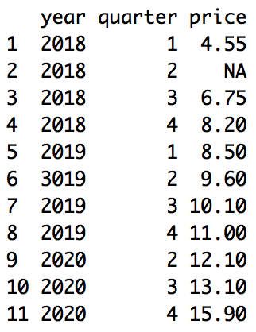
Missing Data
Data can be missing in one of two ways:
Explicitly: The value has a place in the dataset, it just was simply just not recorded and thus receives an ‘NA’.
Implicitly: There is not a row and column for the value.
Explicit
Implicit
df = data.frame(year = c(2018,2018,2018,2018, 2019,2019,2019, 2019,2020,2020,2020),
quarter = c(1,2,3,4,1,2,3,4,2,3,4),
price = c(4.55,NA, 6.75, 8.2, 8.5, 9.6, 10.1, 11.0, 12.1, 13.1, 15.9))
df %>% complete(year, quarter)
df %>% spread(year,price)

Slide 17
Example
WHO TB Data

Slide 19
XML

Slide 21
Example
XML

Slide 23
JSON

Slide 25
Example
JSON

Slide 27
API | Application Programming Interface

Slide 28
API Basics
Data from APIs and Feeds
API: application programming interface
Great for reproducibility
Many R packages for downloading APIs already available
openair
quantmod
treebase
twitteR,
WDI,
rOpenSci
see page 123 of Gandrud
Caution: each package has its own syntax
Many will require you to register and get a key for authentication.

Slide 30
Example
Intrinio

Slide 31

Example: Intrinio

Slide 32
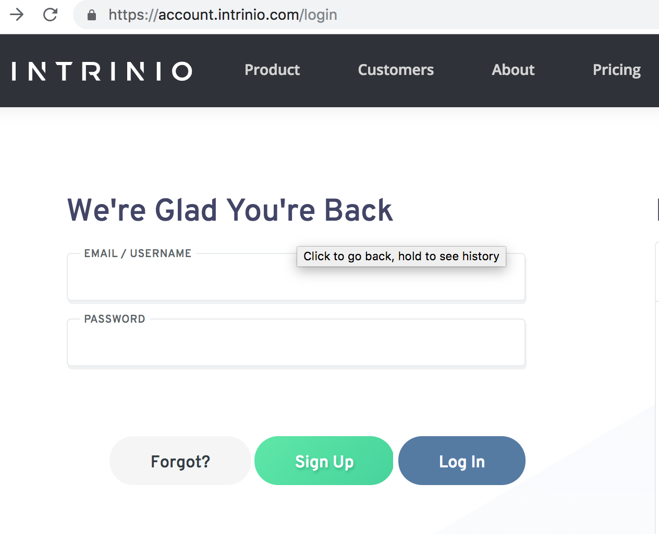
Make an Account
https://account.intrinio.com/login

Slide 33
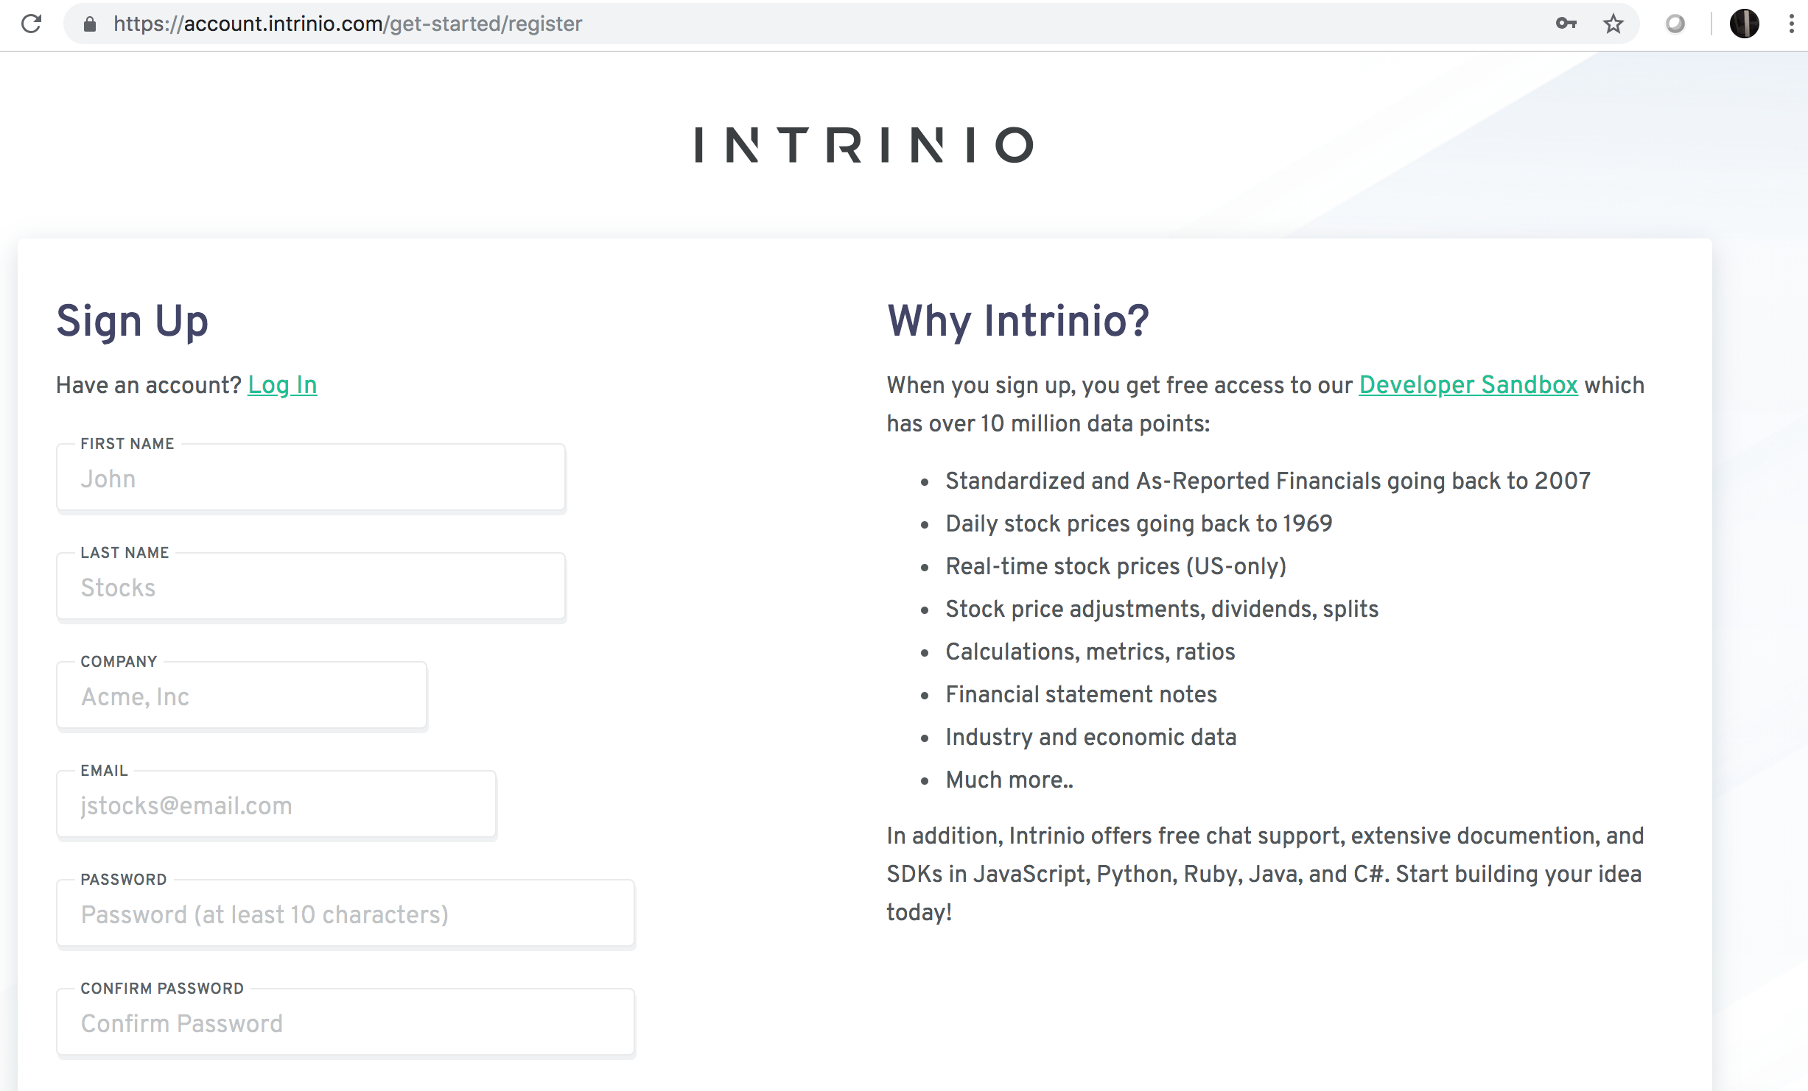
Make an Account

Slide 34
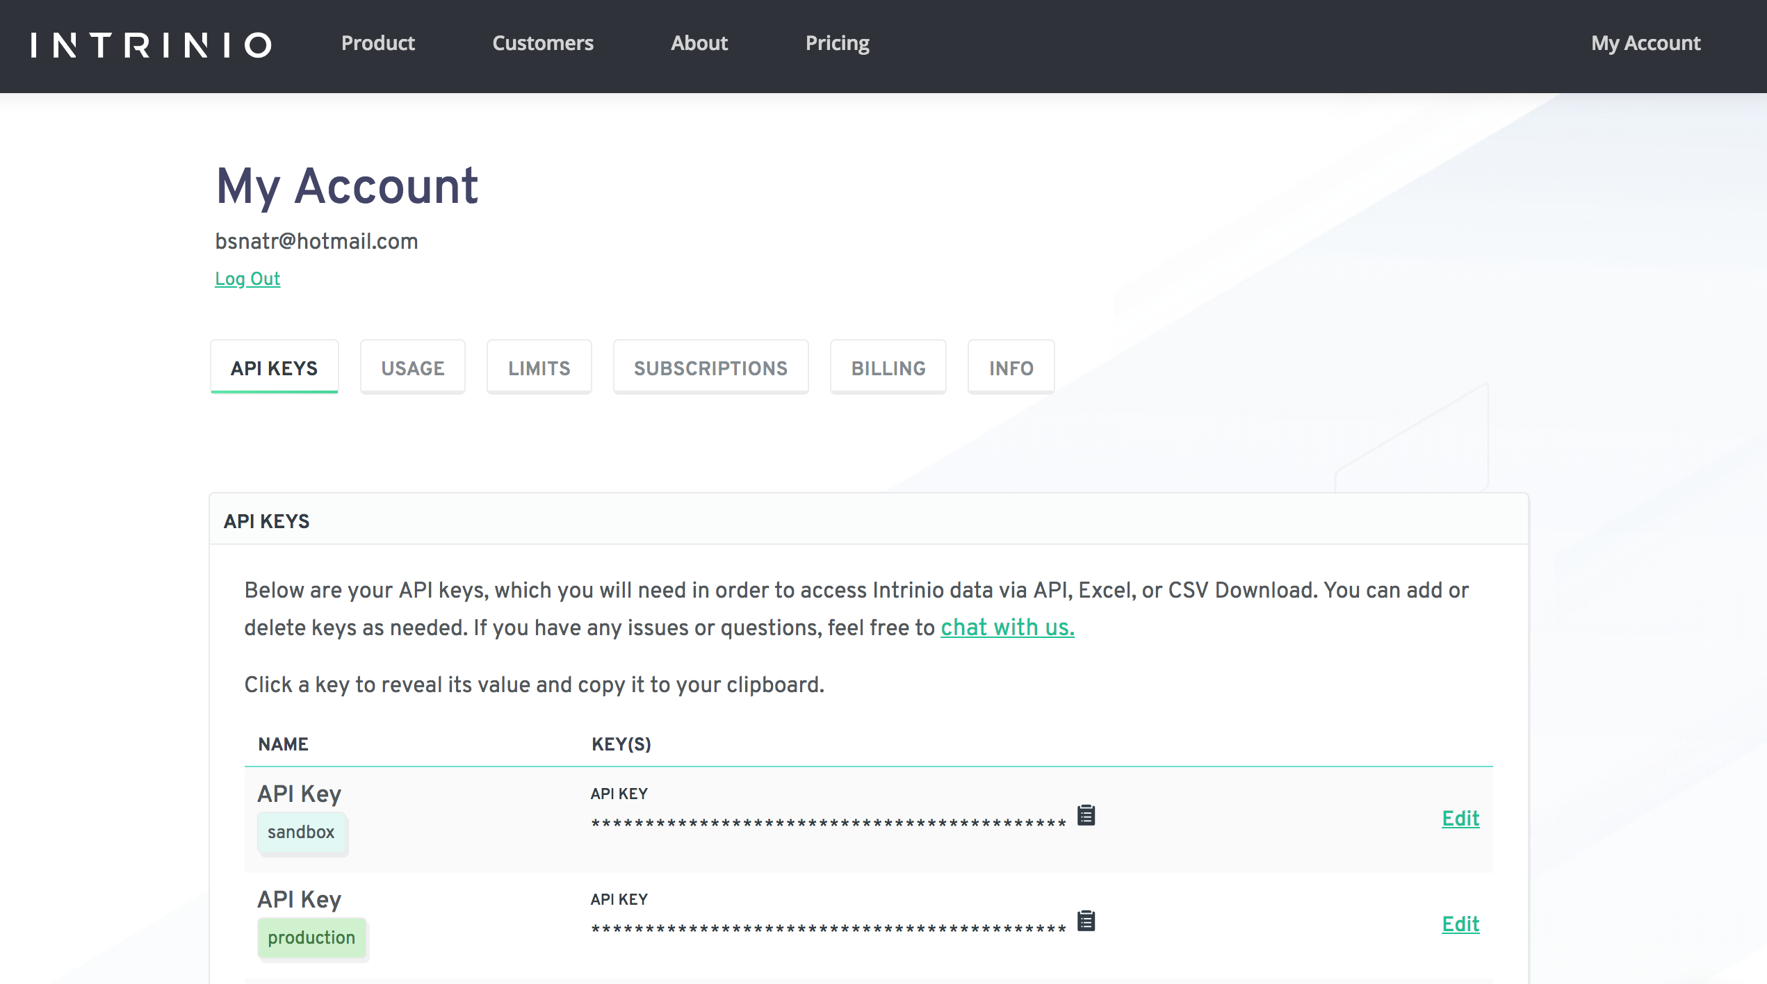
Get API Key

Slide 35
Using the API to Get Stock Prices
#Intrinio
# Andrew Carpenter helpful link: http://old.r-fiddle.org/#/fiddle?id=n1shL0IB&version=1
#Show access through URL: https://api-v2.intrinio.com/companies/AAPL?api_key=OmIxMWI5NWY3MzM0ZjdmN2U3ODJlOTBh
NmU3OGQ0Zjlk
username = "cc092ea39fffe74b69f12976f4bfcd22"
password = "7a8adcf931edb0766ff36fbb0b5cc421"
base <- "https://api.intrinio.com/"
endpoint <- "prices"
stock <- "AAPL"
call1 <- paste(base,endpoint,"?","ticker","=", stock, sep="")
get_prices <- GET(call1, authenticate(username,password, type = "basic"))
get_prices_text <- content(get_prices, "text")
get_prices_json <- jsonlite::fromJSON(get_prices_text, flatten = TRUE)
get_prices_df <- as.data.frame(get_prices_json$data)

Slide 37
Example
Twitter

Slide 38
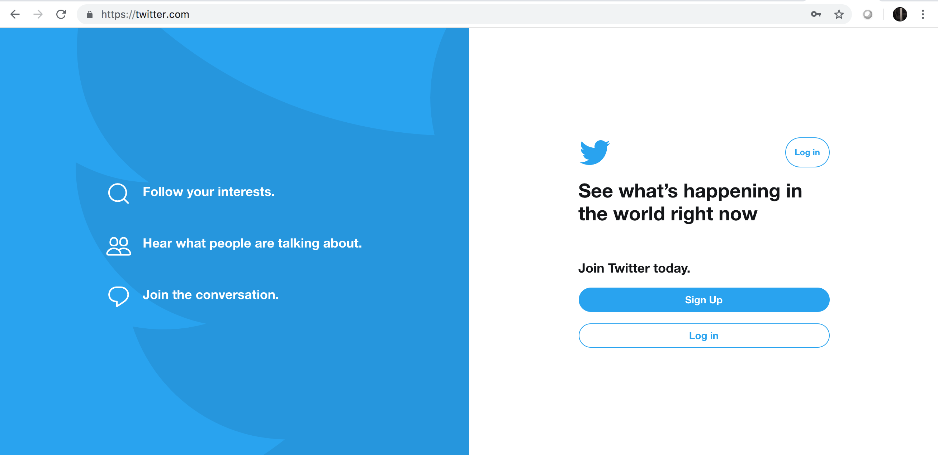
Get a Twitter Account

Slide 39
Example: Twitter
get a twitter account
go to https://apps.twitter.com/app/new
Register API using your Twitter account
get a key and access tokens
api key
api secret
access token
access token secret
Load Library
Get Tweets
searchTwitter()
twListToDF()
Trends
availableTrendLocations()
User Timeline Information
getUser()
userTimeline()

Slide 40
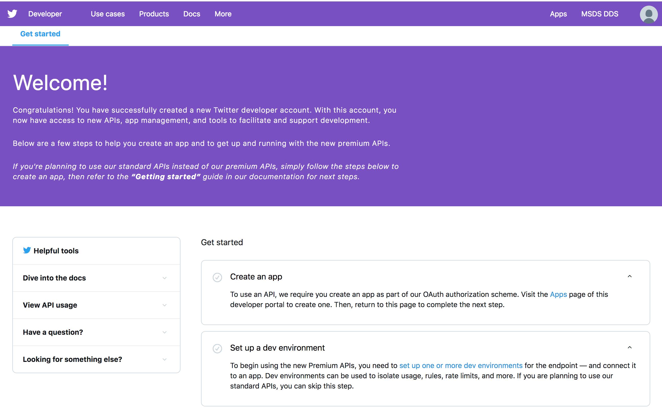
Create App

Slide 41
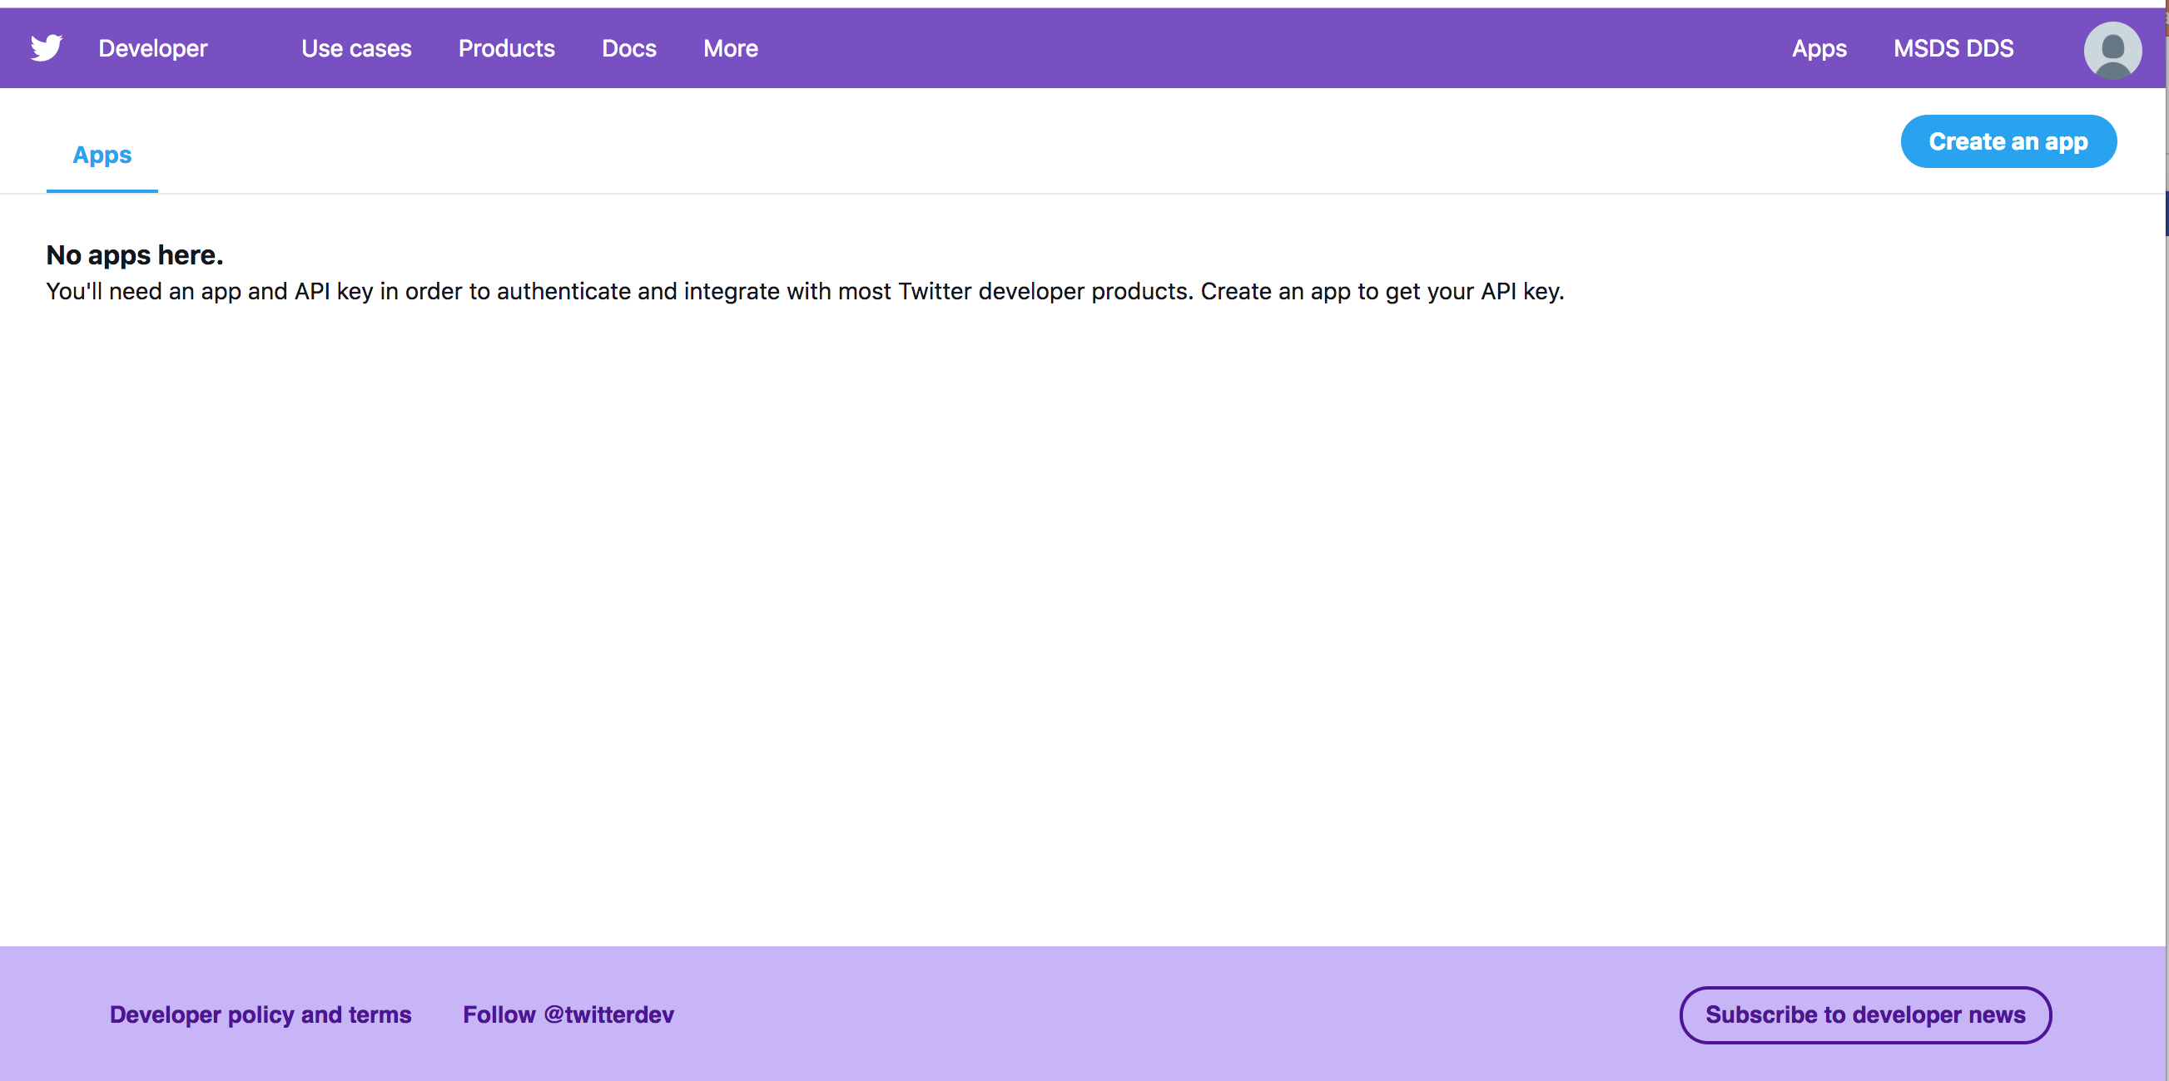
Create App

Slide 42
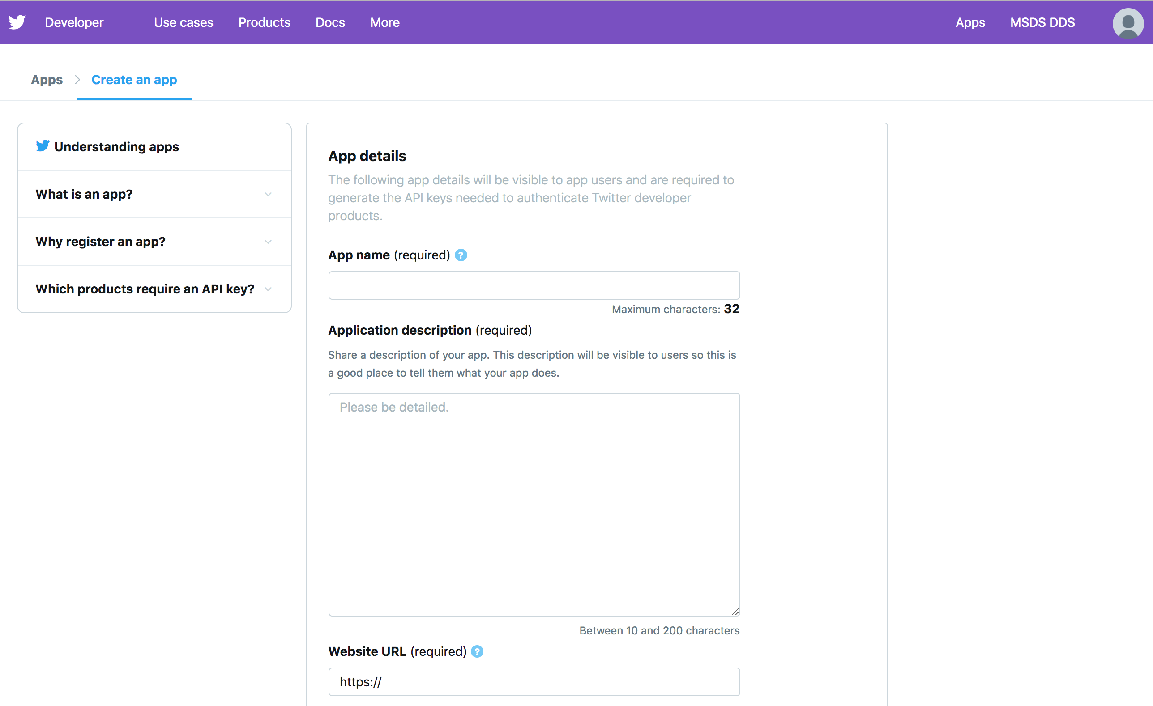
Create an App

Slide 43
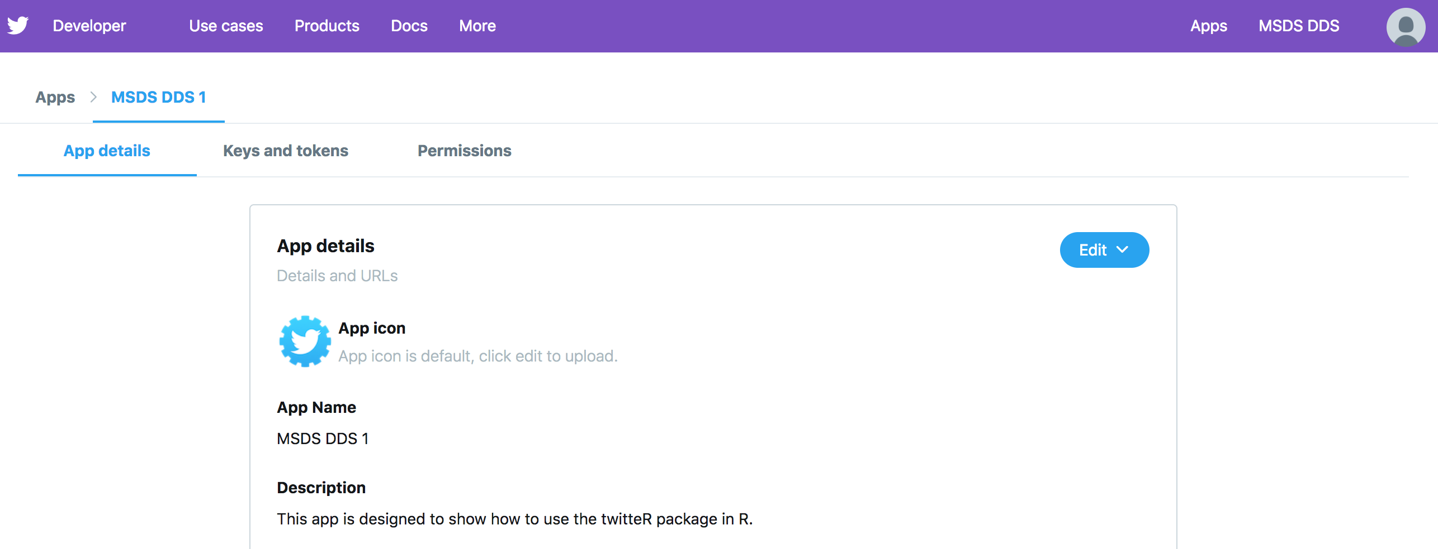
Create an App

Slide 44
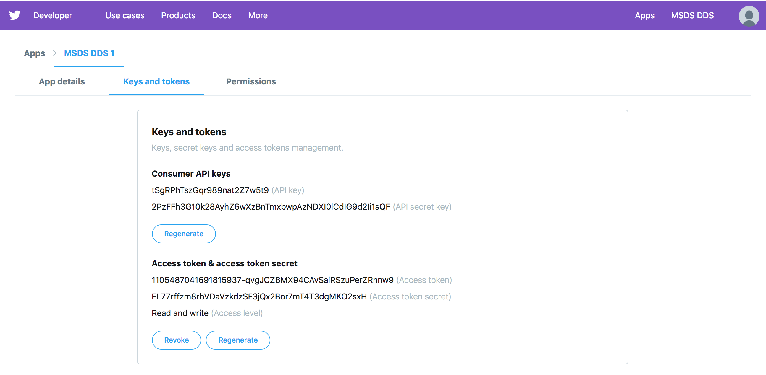
Create an App | API and Token Keys

Slide 45
twitteR Code
#Unit 4 API R Code
#twitteR
api_key = "tSgRPhTszGqr989nat2Z7w5t9"
api_secret = "2PzFFh3G10k28AyhZ6wXzBnTmxbwpAzNDXI0lCdIG9d2Ii1sQF"
access_token = "1105487041691815937-qvgJCZBMX94CAvSaiRSzuPerZRnnw9"
access_token_secret = "EL77rffzm8rbVDaVzkdzSF3jQx2Bor7mT4T3dgMKO2sxH"
#Load twitteR
library(twitteR)
setup_twitter_oauth(api_key,api_secret,access_token,access_token_secret)
#Get tweets
tweets = searchTwitter("$appl", n = 10, lang = "en")
#Locations
trend = availableTrendLocations()
#Get Trends for Location
getTrends(395269) # Caracas, Venezuela
getTrends(2487889) # San Diego, California
getTrends(44418) # London, England
getTrends(2388929) # Dallas, US

Slide 47
Example
World Bank Development API

Slide 48

Example: World Bank Development API
WDI URL API
https://datahelpdesk.worldbank.org/knowledgebase/articles/898599-indicator-api-queries
WDI Indicator Codes / Actual Codes are in an XLS file linked at the bottom.
https://datahelpdesk.worldbank.org/knowledgebase/articles/201175-how-does-the-world-bank-code-its-indicators

Slide 49
WDI | Analysis of Income v. Expenditure
# World Bank Development Indicators
#Goal 1: Create a bar chart of topics relating to gdp.
#search for reports with "gdp" in the description
results = as.data.frame(WDIsearch("gdp"))
#Many reports have more than 4 parts of the indicator
# This is in contrast to this documentation:
#https://datahelpdesk.worldbank.org/knowledgebase/articles/201175-how-does-the-world-bank-code-its-indicators
# We use a new function from a new package that we will cover later: str_count
# This function is in the stringr package and simply counts the number of a specific
# character ("\\.") in a given string (indicator)
# The \\ means to literally look for the '.' which means something else in this context.
#This line will filter the data frame to leave only those with 4 pieces in the indicator.
resultsGoodIndicator = results %>% filter(str_count(indicator,"\\.")==3)
#Check out the new data frame with only 4 piece indicators
resultsGoodIndicator$indicator
# Break the indicator code up into 4 distinct columns.
resultsGoodIndicator = as.data.frame(resultsGoodIndicator) %>% separate(indicator,c("topic","general","specific","extension"))
#plot the topic column in a bar chart to see the frequency of each topic.
#compare the expenditure (NE) and the income (NY)
resultsGoodIndicator %>% ggplot(aes(x = topic, fill = topic)) + geom_bar()

Slide 50
WDI | Analysis of Per Capita GDP by Country
# World Bank Development Indicators
#Goal 2: Plot GDP (NY and GDP) per capita (PCAP) of Mexico, Canada and the US in constant US dollars (KD)
dat = WDI(indicator='NY.GDP.PCAP.KD', country=c('MX','CA','US'), start=1960, end=2012)
head(dat)
library(ggplot2)
ggplot(dat, aes(x = year, y = NY.GDP.PCAP.KD, color=country)) + geom_line() +
xlab('Year') + ylab('GDP per capita')

